Slide 1
ROUTER
by Mykola Sotula

Slide 2

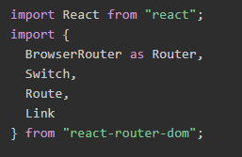
INSTALLATION & IMPORT

Slide 3
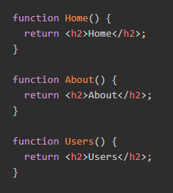
BASIC
In this example we have 3 “pages” handled by the router: a home page, an about page, and a users page.

Slide 4
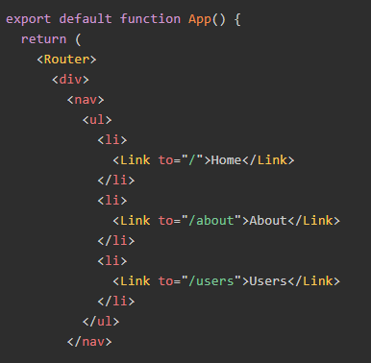
BASIC
As you click around on the different <Link>s, the router renders the matching <Route>.

Slide 5
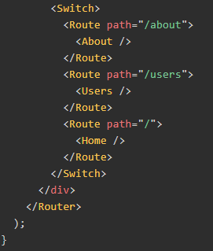
BASIC
A <Switch> looks through its children <Route>s and renders the first one that matches the current URL.
Note: Behind the scenes a <Link> renders an <a> with a real href, so people using the keyboard for navigation or screen readers will still be able to use this app.

Slide 6
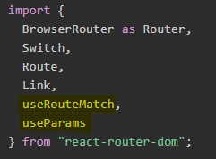
NESTED
This example shows how nested routing works.
Import useRouteMatch and useParams

Slide 7
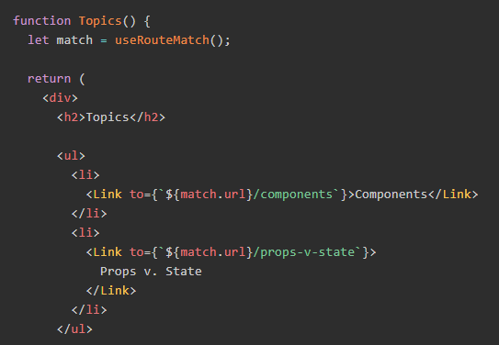
NESTED
The route /topics loads the Topics component, which renders any further <Route>'s conditionally on the paths :id value.

Slide 8
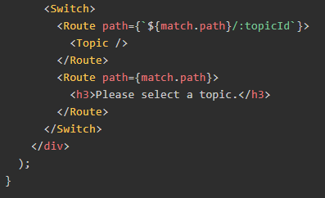
NESTED
The Topics page has its own <Switch> with more routes that build on the /topics URL path. You can think of the 2nd <Route> here as an "index" page for all topics, or the page that is shown when no topic is selected

Slide 9
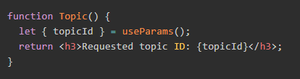
NESTED
As example – Topic component with info about id.

Slide 10
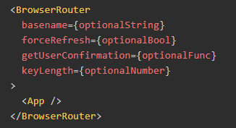
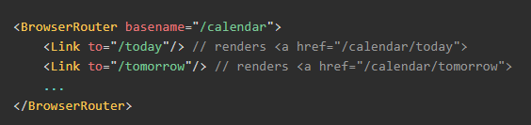
API BROWSERROUTER
A <Router> that uses the HTML5 history API (pushState, replaceState and the popstate event) to keep your UI in sync with the URL.
basename: string
The base URL for all locations. If your app is served from a sub-directory on your server, you’ll want to set this to the sub-directory. A properly formatted basename should have a leading slash, but no trailing slash.

Slide 11
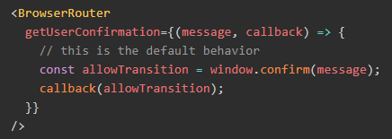

API BROWSERROUTER
getUserConfirmation: func
A function to use to confirm navigation. Defaults to using window.confirm.
forceRefresh: bool
If true the router will use full page refreshes on page navigation. You may want to use this to imitate the way a traditional server-rendered app would work with full page refreshes between page navigation.

Slide 12

API BROWSERROUTER
keyLength: number
The length of location.key. Defaults to 6.
children: node
The child elements to render.Note: On React < 16 you must use a single child element since a render method cannot return more than one element. If you need more than one element, you might try wrapping them in an extra <div>.

Slide 13


API ROUTE
The Route component is perhaps the most important component in React Router to understand and learn to use well. Its most basic responsibility is to render some UI when its path matches the current URL.
path: string | string[]
Any valid URL path or array of paths that path-to-regexp@^1.7.0 understands.
Routes without a path always match.

Slide 14



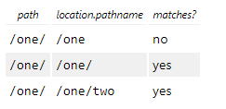
API ROUTE
exact: bool
When true, will only match if the path matches the location.pathname exactly.
strict: bool
When true, a path that has a trailing slash will only match a location.pathname with a trailing slash. This has no effect when there are additional URL segments in the location.pathname.

Slide 15

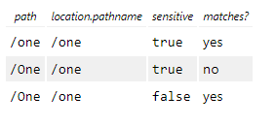
API ROUTE
sensitive: bool
When true, will match if the path is case sensitive.

Slide 16
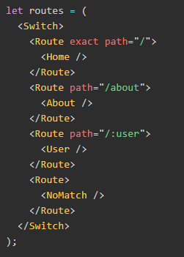
API SWITCH
<Switch>
Renders the first child <Route> or <Redirect> that matches the location.
How is this different than just using a bunch of <Route>s?
<Switch> is unique in that it renders a route exclusively. In contrast, every <Route> that matches the location renders inclusively.

Slide 17
API HOOKS
React Router ships with a few hooks that let you access the state of the router and perform navigation from inside your components.
useHistory
useLocation
useParams
useRouteMatch

Slide 18
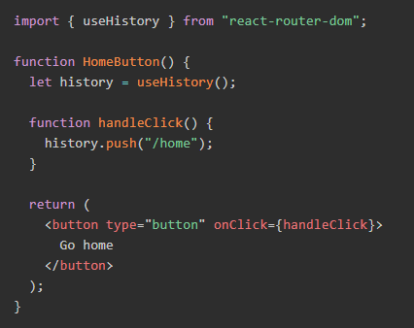
API USEHISTORY
The useHistory hook gives you access to the history instance that you may use to navigate.

Slide 19
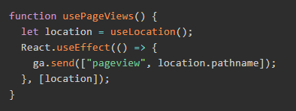
API USELOCATION
The useLocation hook returns the location object that represents the current URL. You can think about it like a useState that returns a new location whenever the URL changes.
This could be really useful e.g. in a situation where you would like to trigger a new “page view” event using your web analytics tool whenever a new page loads, as in the following example:

Slide 20
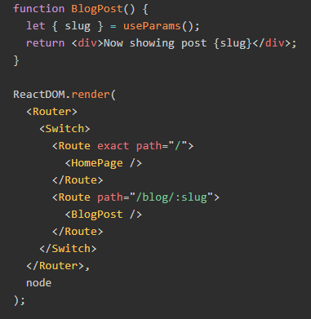
API USEPARAMS
useParams returns an object of key/value pairs of URL parameters. Use it to access match.params of the current <Route>.

Slide 21
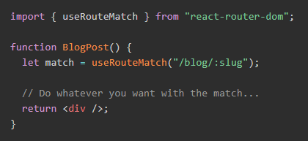
API USEROUTEMATCH
The useRouteMatch hook attempts to match the current URL in the same way that a <Route> would. It’s mostly useful for getting access to the match data without actually rendering a <Route>.

Slide 22


